Slide 1
Introduction
Windows Presentation Foundation

Slide 2
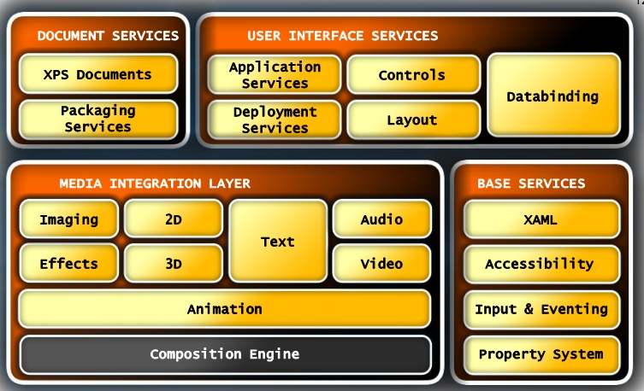
Architecture

Slide 3
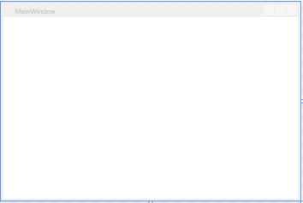
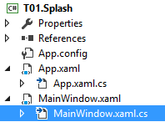
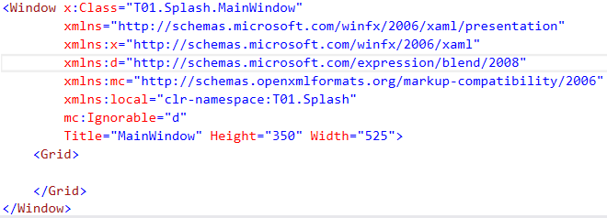
HelloWorld
Code behind in cs file

Slide 4
Fundamental things
Seperation
UI (XAML)
Business logic (C# / VB.Net)
All graphics are Direct2D (part of DirectX)
Hardware accelerated
Vector based graphics: no quality loss when zoom
Using style like CSS

Slide 5
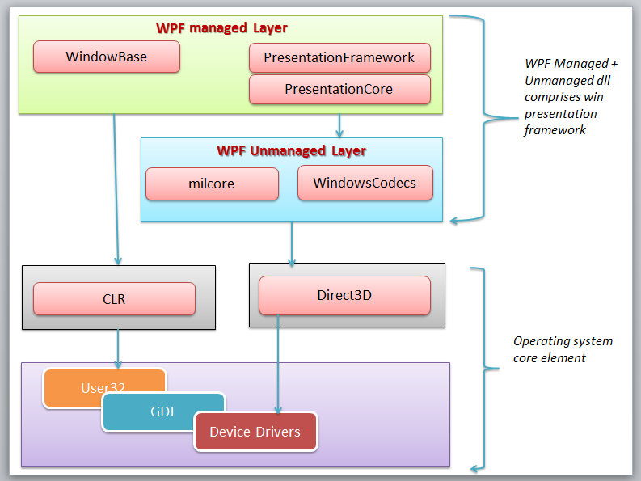
WPF Layers

Slide 6
XAML
Pronounced “zammel”
eXtensible Application Markup Language
Markup language like XML
Declarative language vs Imperative
“What” vs “How”

Slide 7
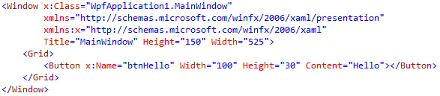
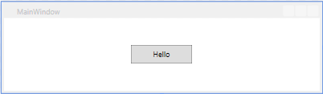
Basic features
Root
Properties

Slide 8
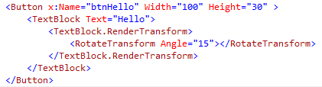

Complex properties

Slide 9


Button – Declare vs Create
XAML code to declare a button
C# Code to create a button
No difference in execution & speed
Main difference: separation from UI & Business logic

Slide 10



Event handler

Slide 11
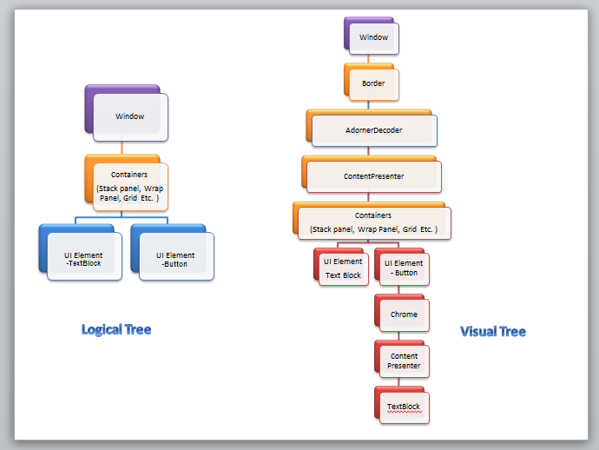
Visual Tree vs Logical Tree

